Slide 1
Metrics to evaluate regression models
How to know if a regression model works well?

Slide 2
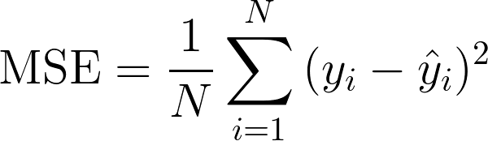
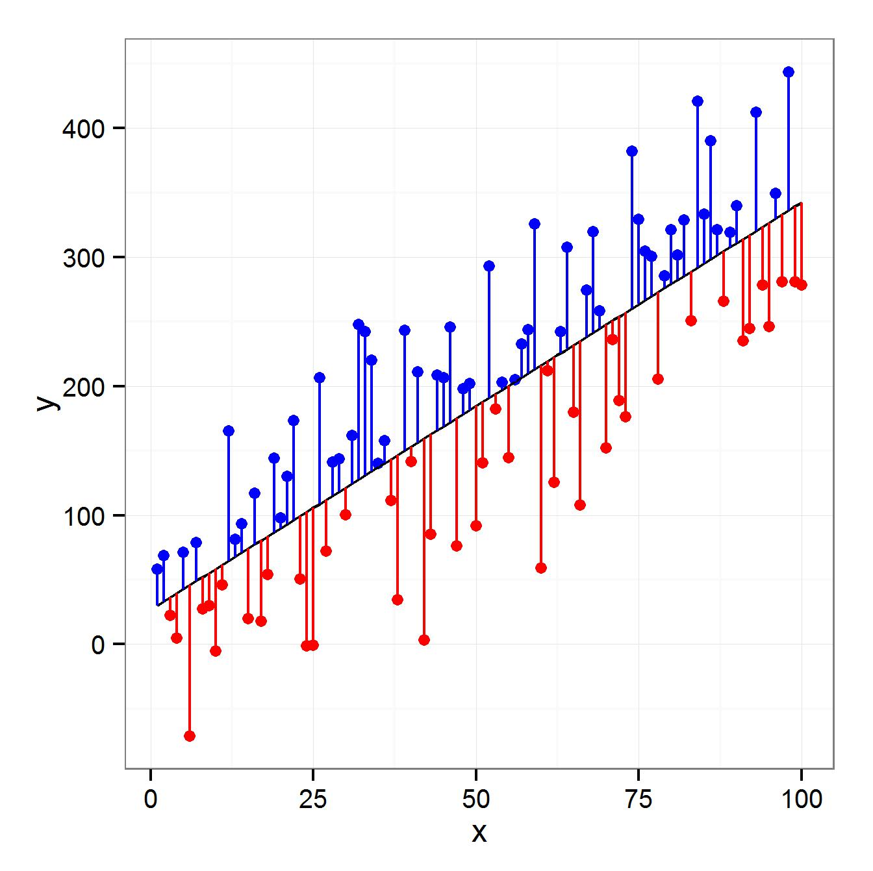
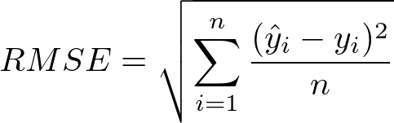
Regression Evaluation: RMSE and MSE
Errors
MSE=Mean Squared Error. RMSE=Root Mean Squared Error.
If you notice, they are very similar (the root square). In out House Price regression problem, image the RMSE = 5.090. This means that the average error we are making is 5.090 $. Is it big or not? It depends: in the houses problem is small because the mean house value >50K $.

Slide 3
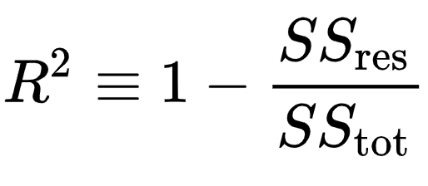
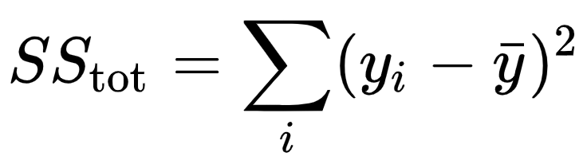
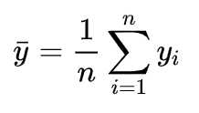
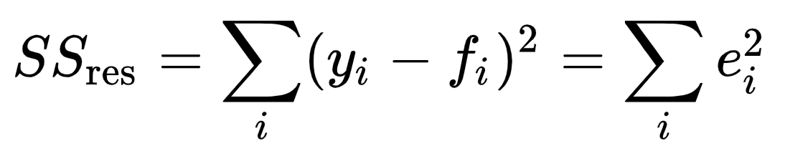
Regression Evaluation: R2 (R squared) a.k.a Coefficient of determination (LINK)
e
R2 score is between -infinite and 1, always. It can’t be more than 1.
It compares the SSres = sum of errors of the regressor(squared). with SStot that is the total variance of the data (measure of dispersion around the mean of the signal).

Slide 4
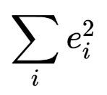
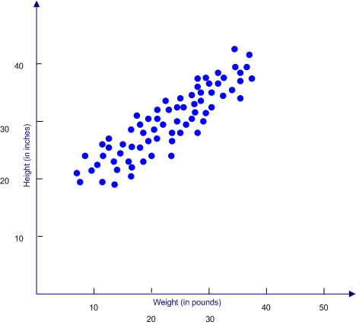
Regression Evaluation: R2 (R squared) a.k.a Coefficient of determination (LINK)
Having said that, if you think about the formulas, it is doing this:
With the regressor, calculate the that is a measure of error
Take your real target values, plot them, and draw an horizontal line corresponding to the mean and calculate again the sum of error squared and call it SStot. (this is equivalent as calculating the variance of target real values)
The R2 score compare the errors made by your model and the by the horizontal line. R2 score tells you how much your model is better than predicting the values using the mean of the signal.
If R2 score = 0, so your model is useless because the green line (the mean) is predicting as well as your model! :)

Slide 5
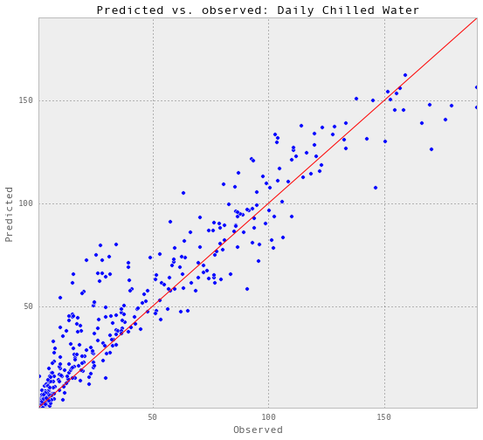
R2 Square: second way to think it
If we plot the scatter plot Real target values vs Predicted and if the model is able to perfectly predict the values, we would expect that the blu points describe a line.
In this case (in the figure), we see that the predicted values drift a little from the real ones. This is normal.
So, the more the blue points (Real vs Predicted) are approaching a line, the higher is R2 score (towards 1).
R2 score is linked to the concept of “explained variance”: it tells you how much variance (information) the model can “explain”.

Slide 6

How do you evaluate a regression model?
Generally it is possible to use 2 metrics: RMSE and R2 Score
RMSE quantify us the average error our model is doing in the regression task. For example, evaluating the price of houses given Area, an RMSE of 1000$ tells us that the average error is 1000$. High or low? Depends on the average house price.
R2 Score tells us how well the regression model is able to describe the data and it is a sort of quality index of the fitting (fitting means then a regressor describe the data). R2 score ranges from -infinite to 1 (be careful: 1, in the test set, is impossible, when you see it, something is surely wrong). The data has always a part of noise that cannot be predicted so a model is NEVER able to predict perfectly the target. All the next definitions are valid (and are closing related one with the other):
R2 score tells us the % of improvement of the model compared to a mean model (represented by the mean rect) because is compares the error of the fitting with the error of the mean model (doing a ratio).
R2 score is related to the portion (%) of “variance” that the model “understood” from the data.
R2 score tells you how much the point in a plot (Real_values vs Predicted) approach a rect.

Slide 7

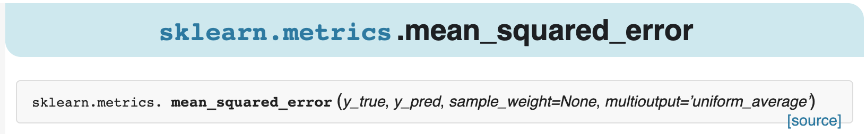
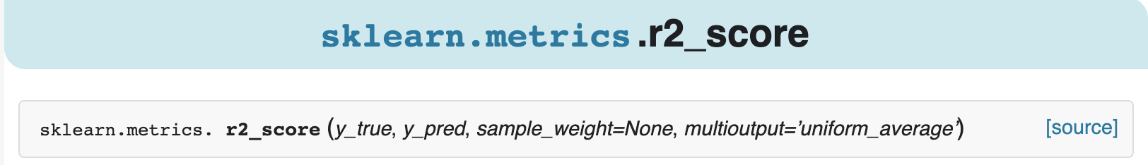
Sklearn: RMSE and R2 Score

Slide 8
Go to Notebook Regression Metrics
Section 1

